Slide 1
Introduction to Bioinformatics
In the name of the most high
Differentiation
Ali Sharifi-Zarchi
Department of Computer Engineering, Sharif University of Technology
These slides are available under the Creative Commons Attribution License.

Slide 2
The Secret of
Cellular Diversity

Slide 3
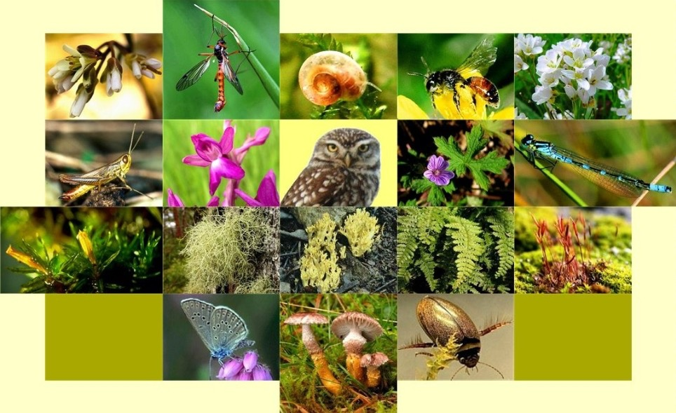

Biological Diversity
http://www.greenrooftechnology.com/biodiversity

Slide 4
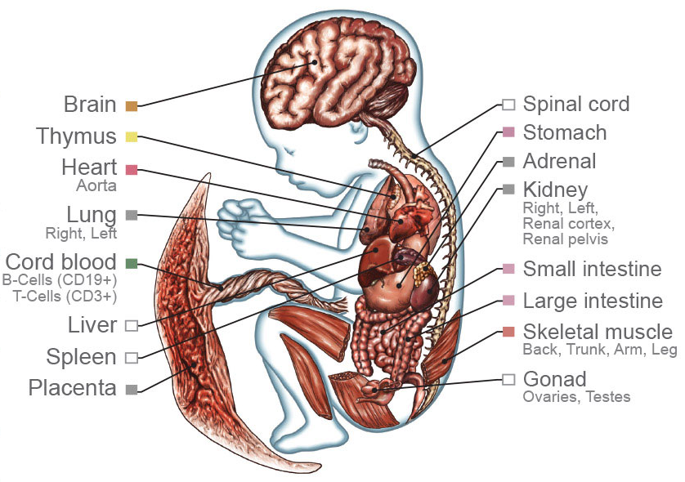
Diversity in Our Body
http://www.nih.gov/news/health/feb2015/images/niehs-18_xl.jpg

Slide 5
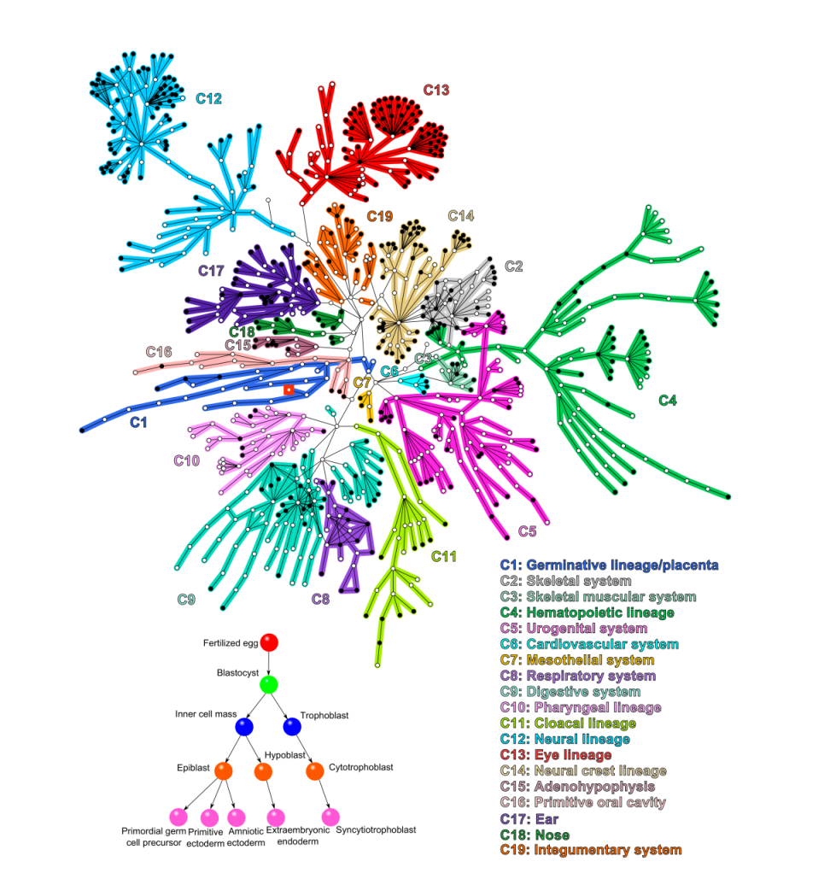
Differentiation Network
Galvão, V., et.al. PNAS (2010)

Slide 6
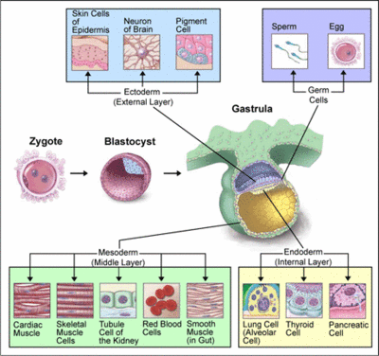
Human Development

Slide 7
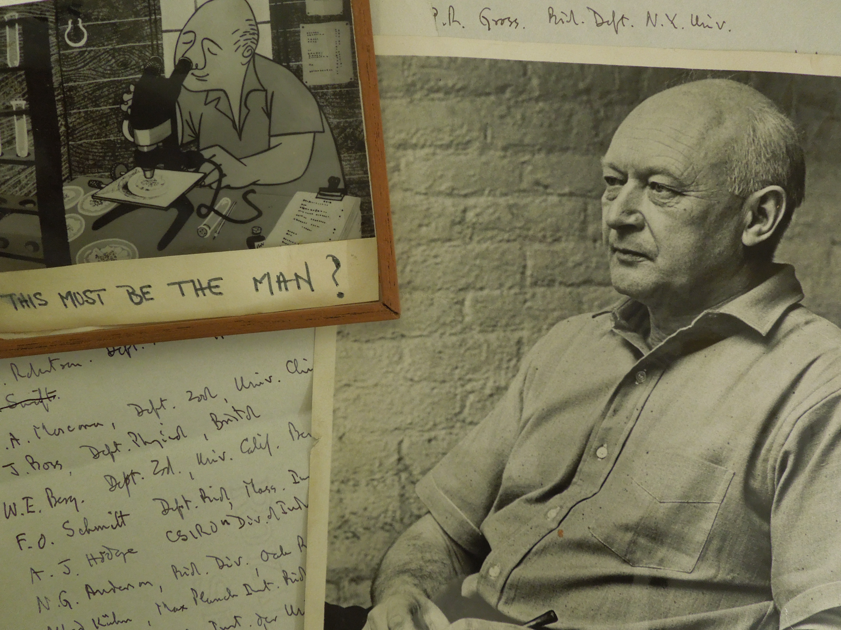
Conrad H. Waddington
http://libraryblogs.is.ed.ac.uk/towardsdolly/2012/09/28/wad-conrad-hal-waddington-1905-1975

Slide 8
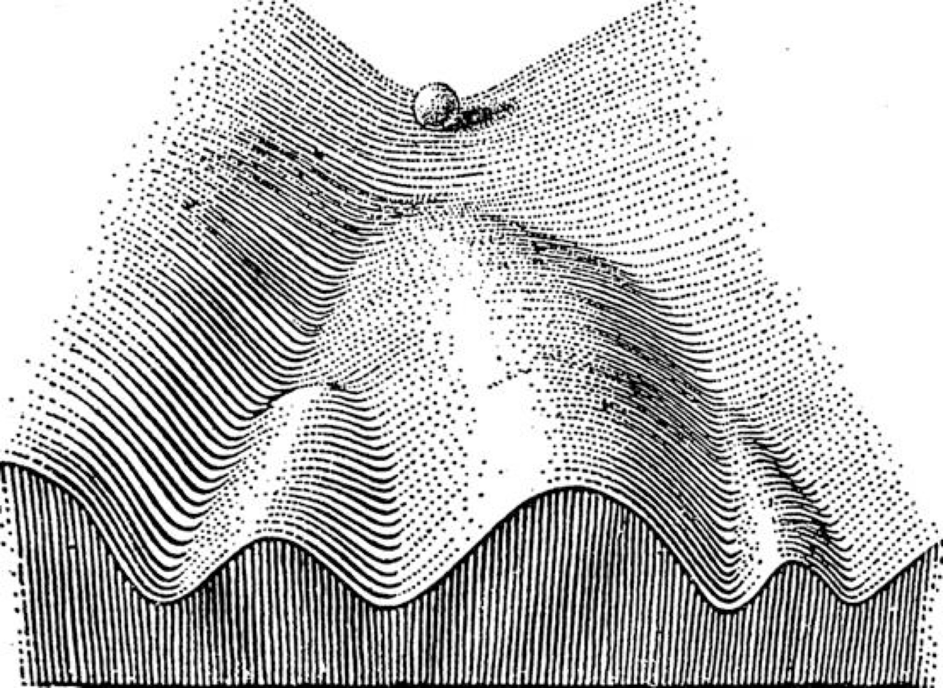
Epigenetic Landscape
.Waddington, C H. The Strategy of the Genes. London: George Allen & Unwin, 1957

Slide 9
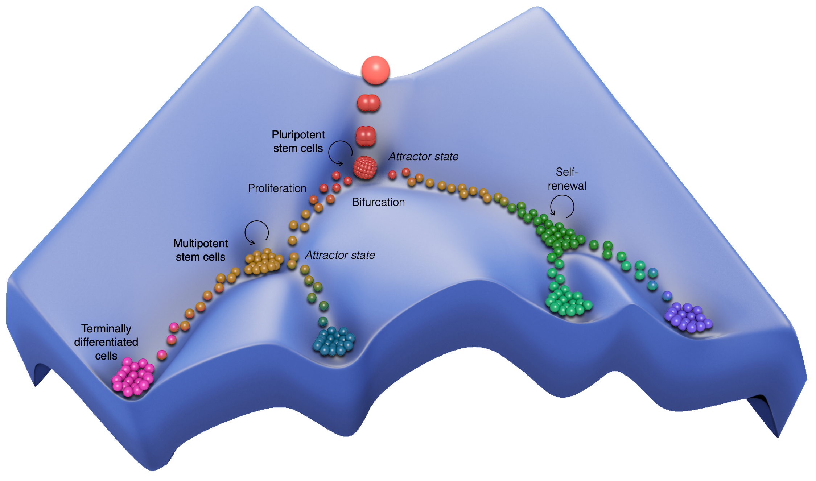
Epigenetic Landscape
Courtesy of Ms. Razieh Karamzadeh, Royan Institute for Stem Cell Biology & Technology

Slide 10
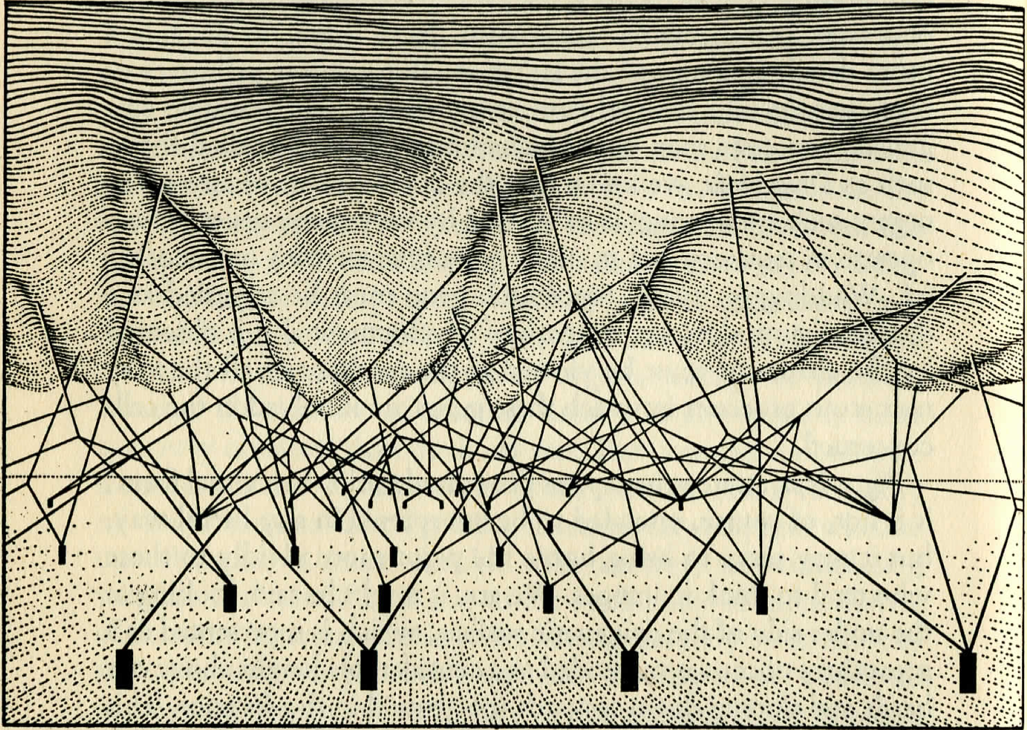
The Landscape Backstage
.Waddington, C H. The Strategy of the Genes. London: George Allen & Unwin, 1957

Slide 11
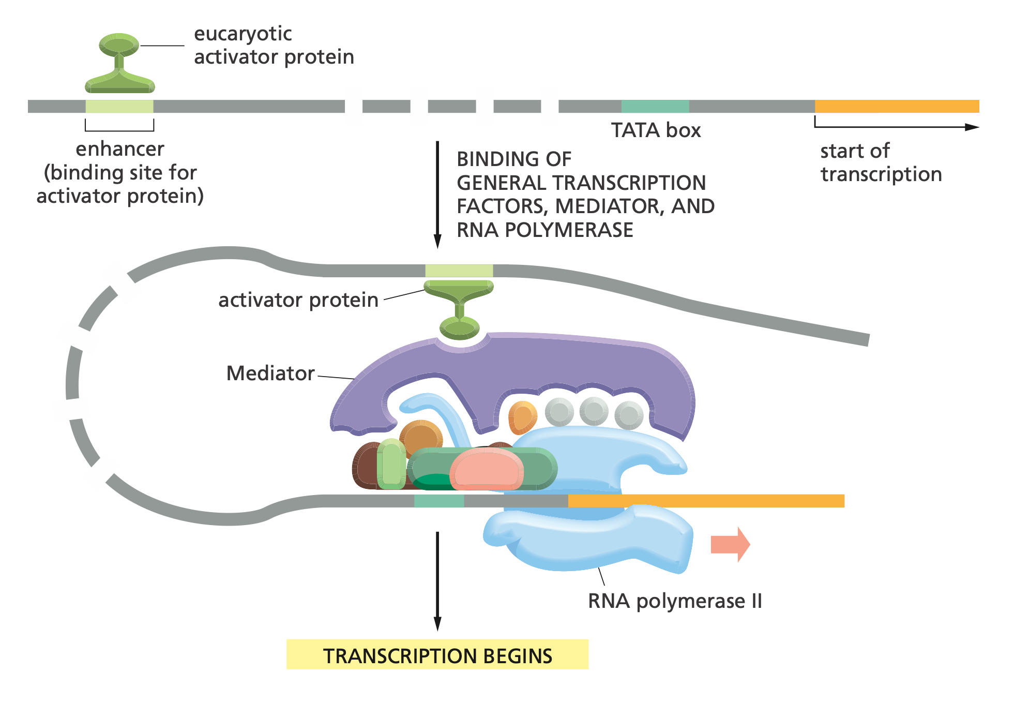
How do Genes Interact?
Alberts B., et al., Essential Cell Biology, 3rd Edition

Slide 12
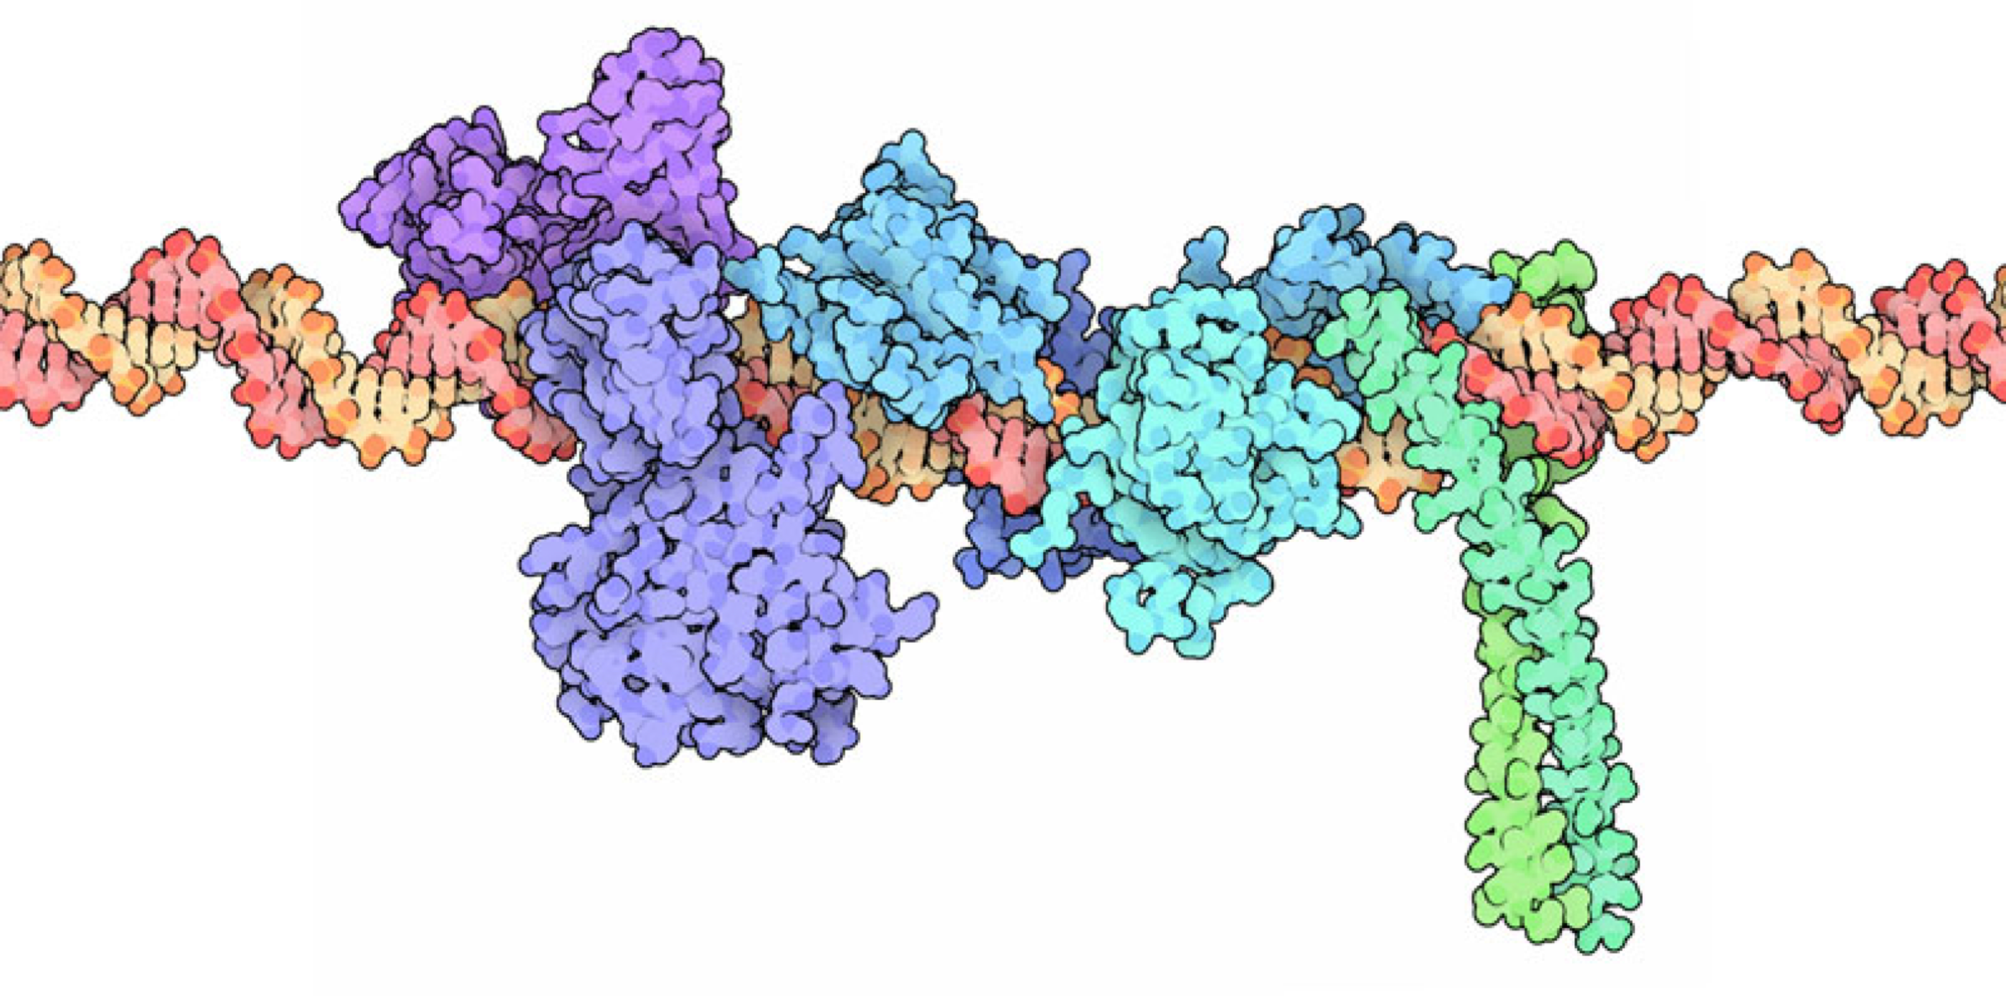
Transcription Factor Bound to Enhancer
http://www.rcsb.org/pdb/101/motm.do?momID=122

Slide 13
Motifs

Slide 14
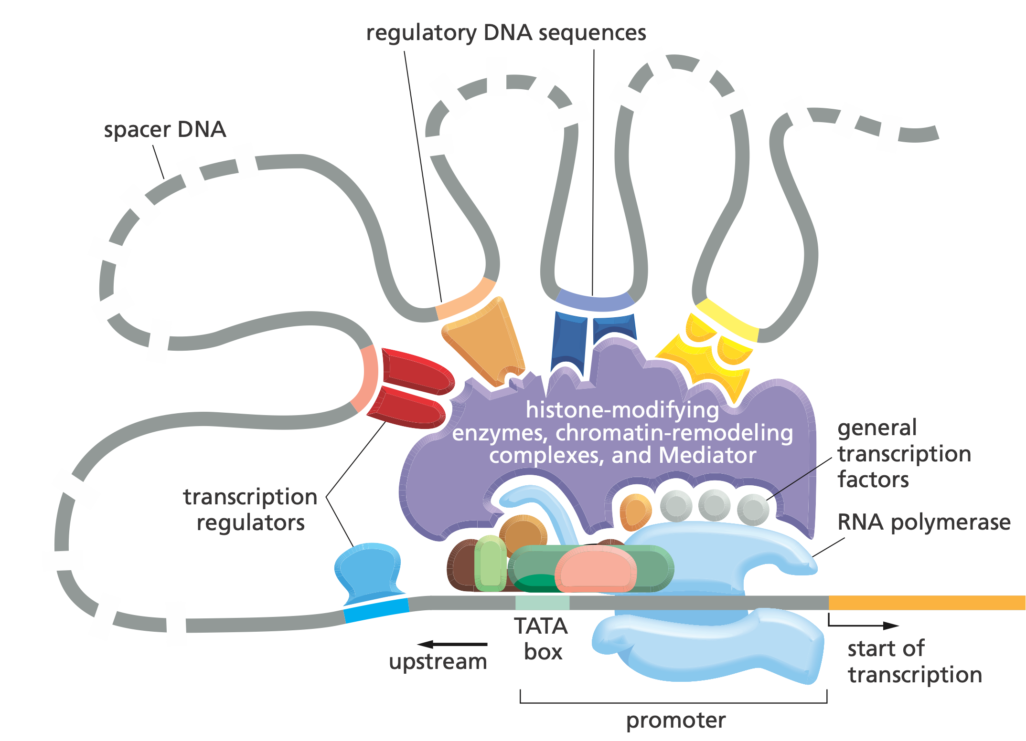
Can be More Complicated
Alberts B., et al., Essential Cell Biology, 3rd Edition

Slide 15
Gene Regulatory Networks (GRN)
Guocai Chen, et al., PLoS Computational Biology (2014)

Slide 16
Li Guo, et al., New Phytologist (2016)
Notes:
Fusarium graminearum (a yeast) GRN

Slide 17
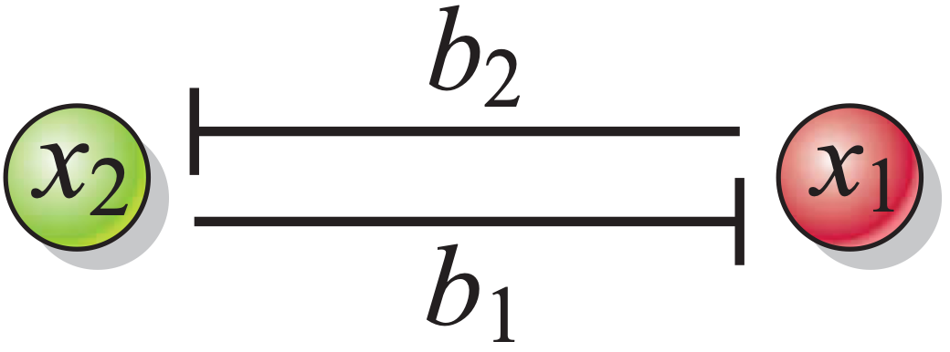
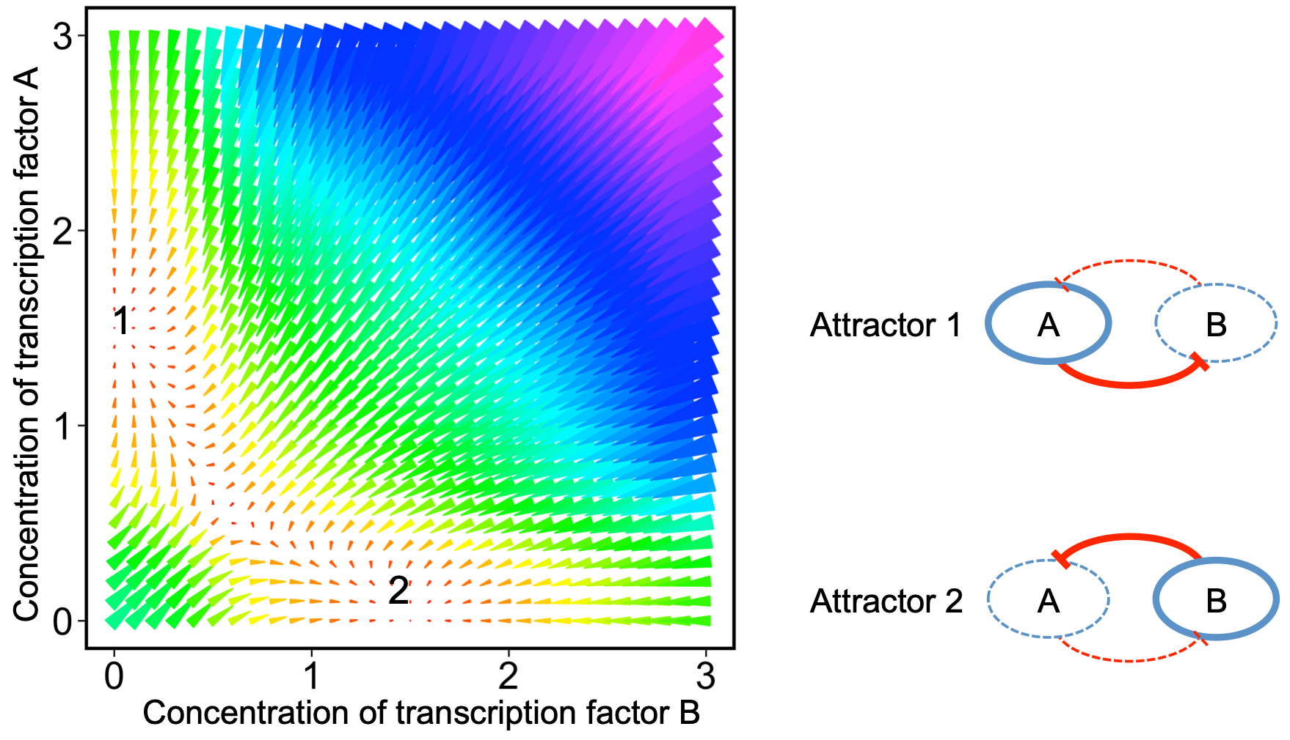
Bistable Switch

Slide 18
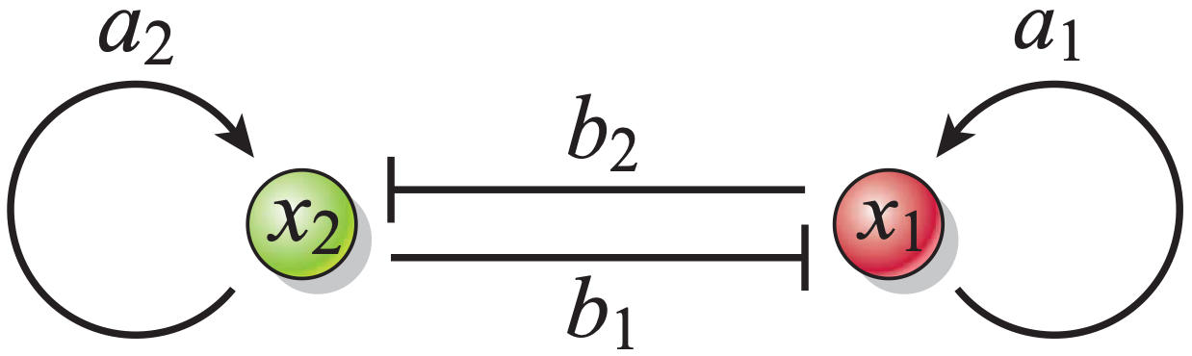
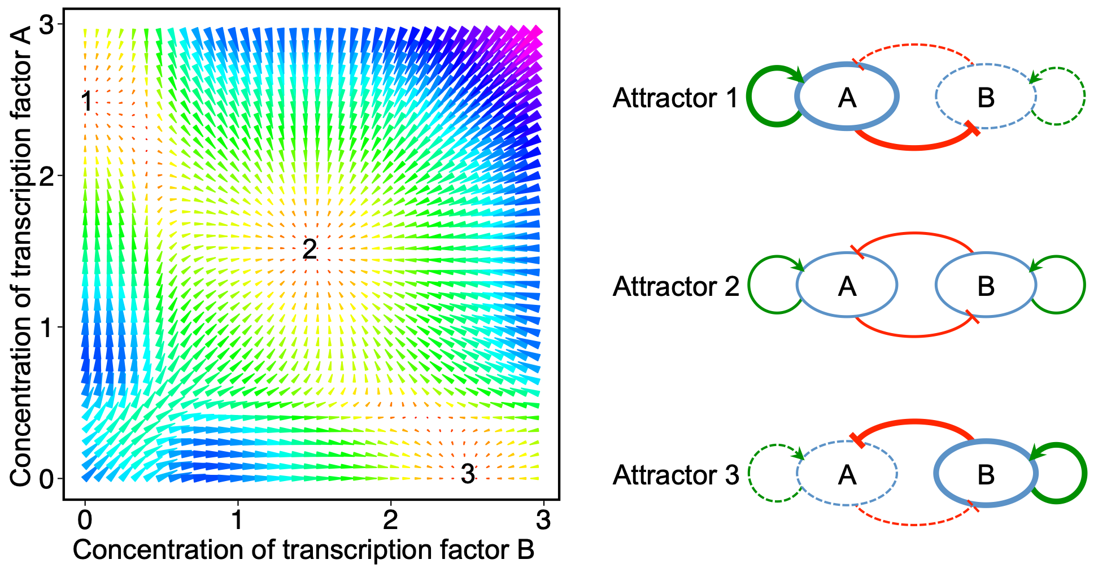
Tristable Switch

Slide 19
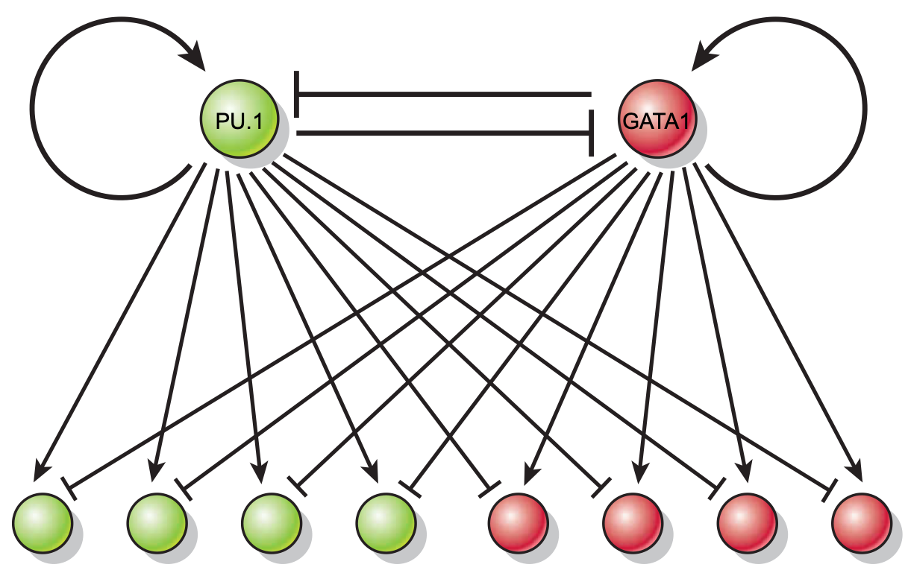
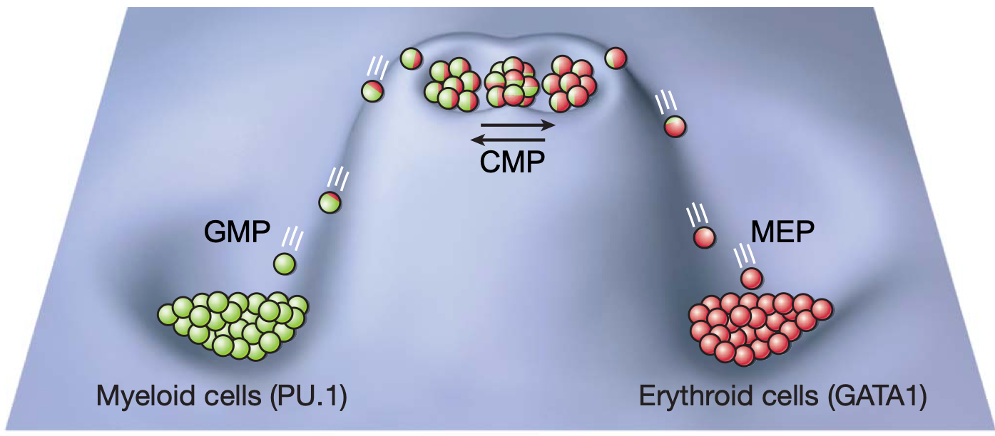
Lineage Bifurcation
Graf, Thomas and Enver, Tariq. Nature, 462(7273):587– 594 (2009).

Slide 20
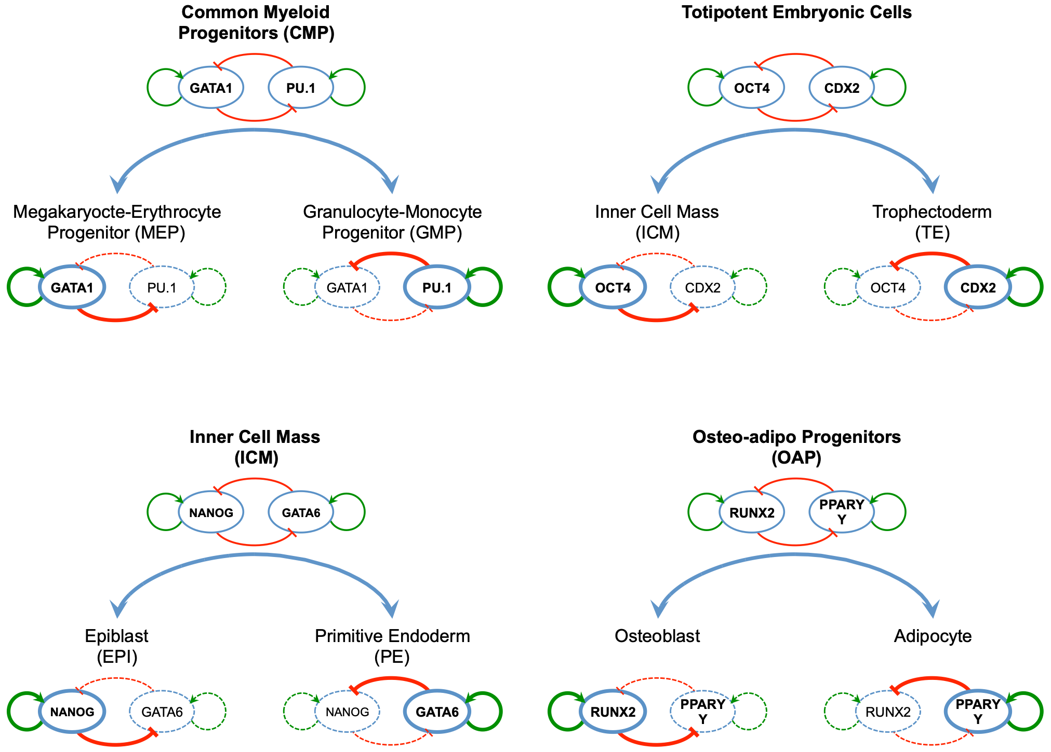
Human Development

Slide 21
How to Model a Switch?

Slide 22

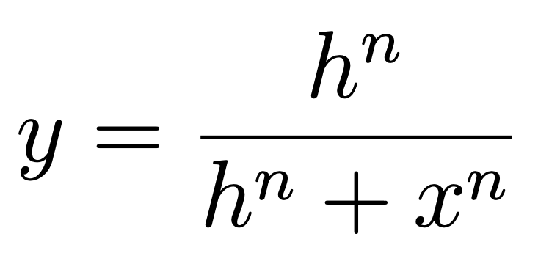
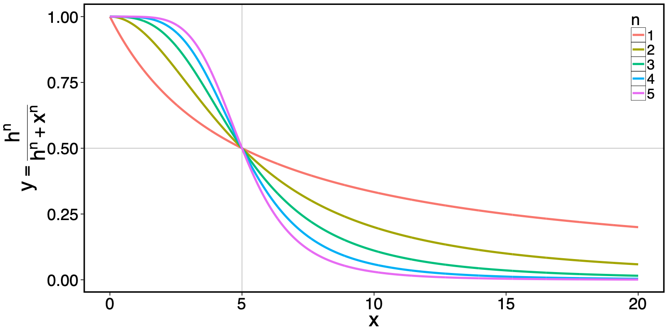
Mutual Inhibition

Slide 23
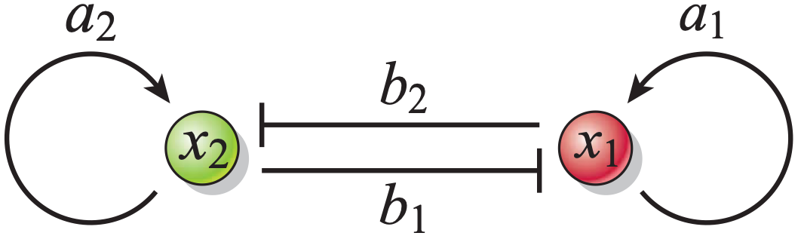
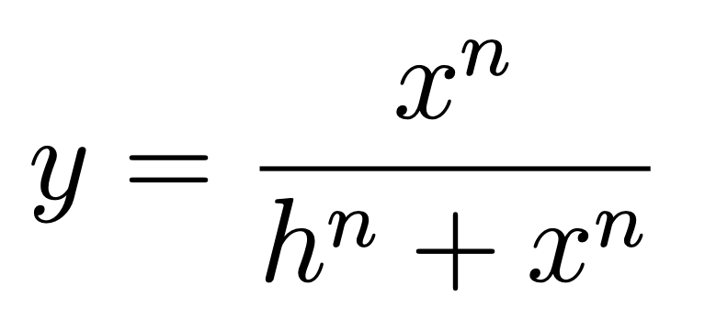

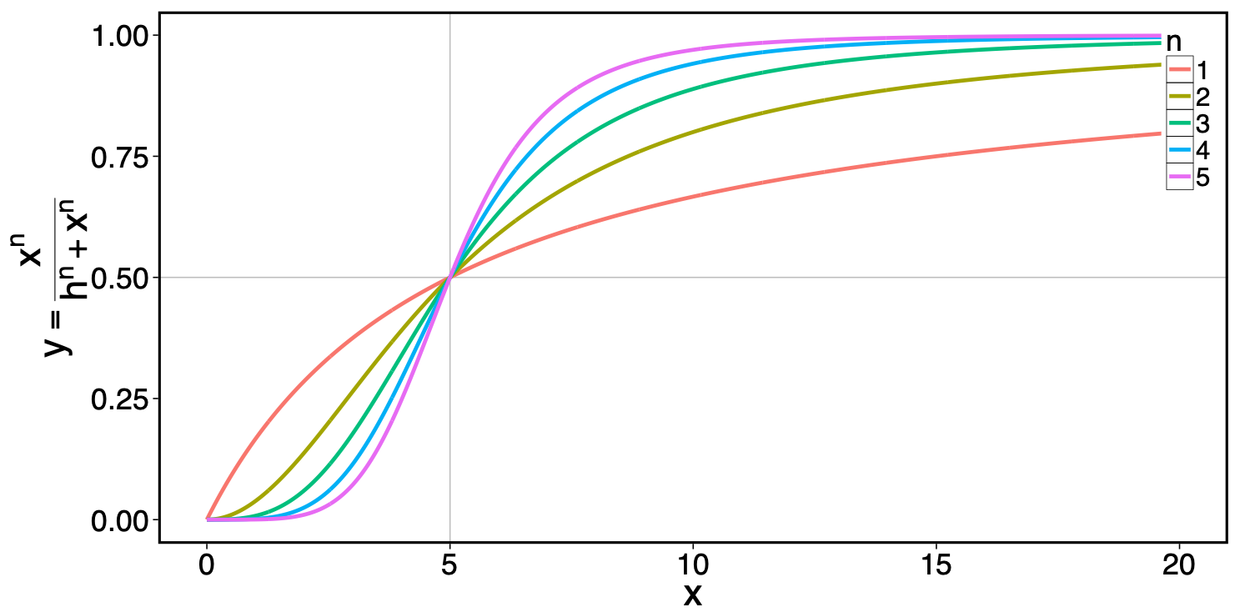
Self Activation

Slide 24
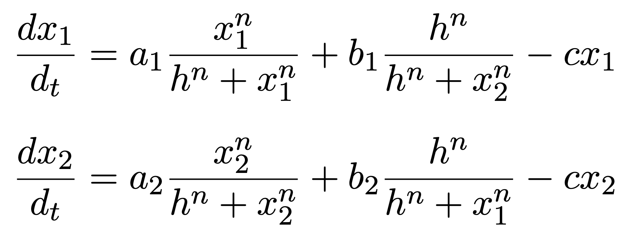
Ordinary Differential Equations (ODEs)

Slide 25
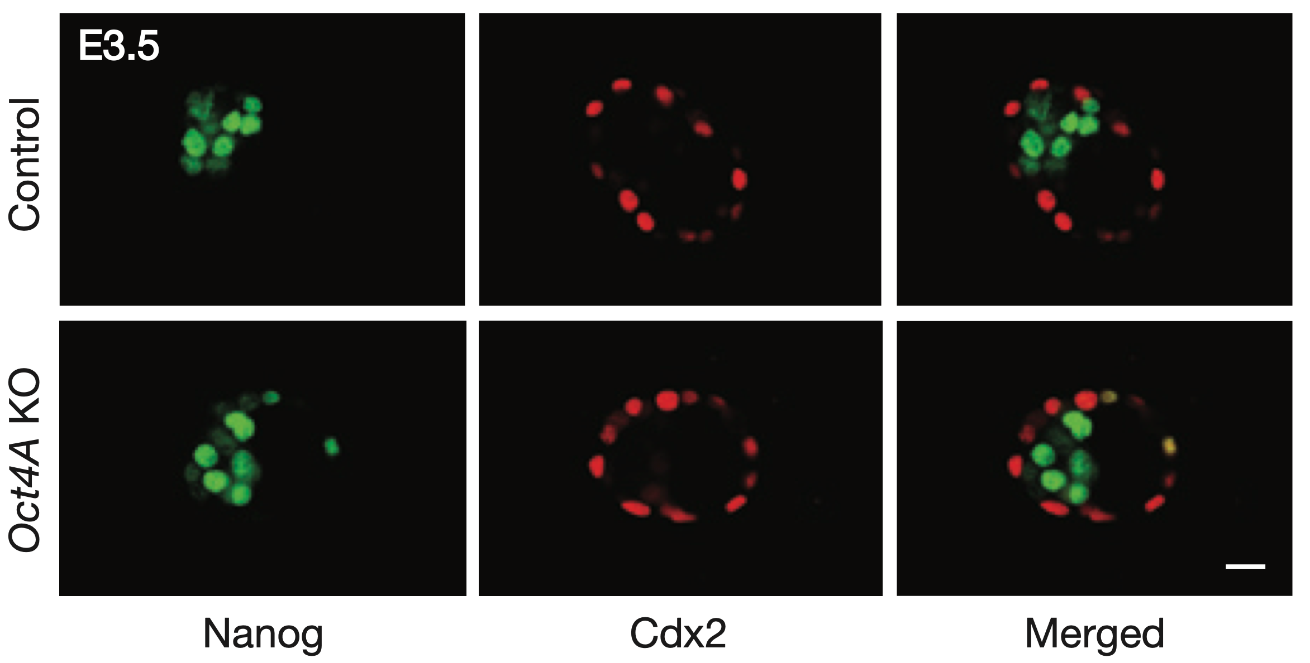
Controversy
Wu, G., et al. Nature Cell Biology, 15(9), 1089–1097 (2013).

Slide 26
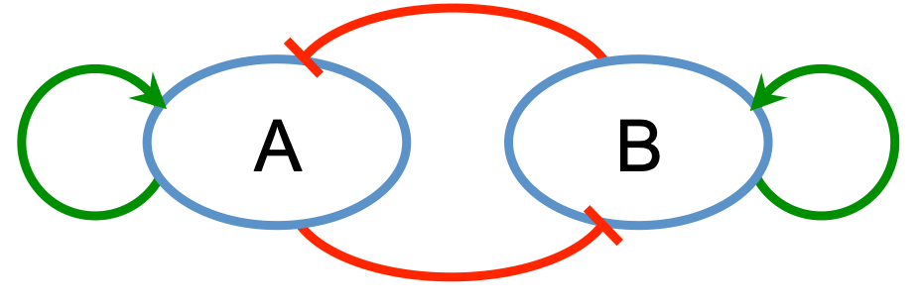
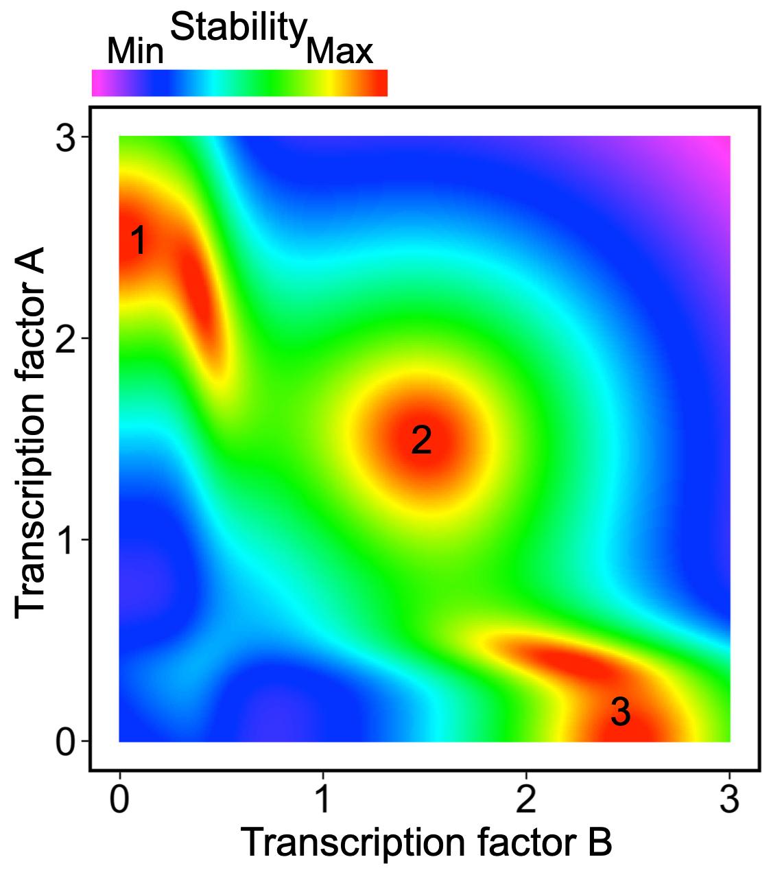
Two-Factor Circuit

Slide 27
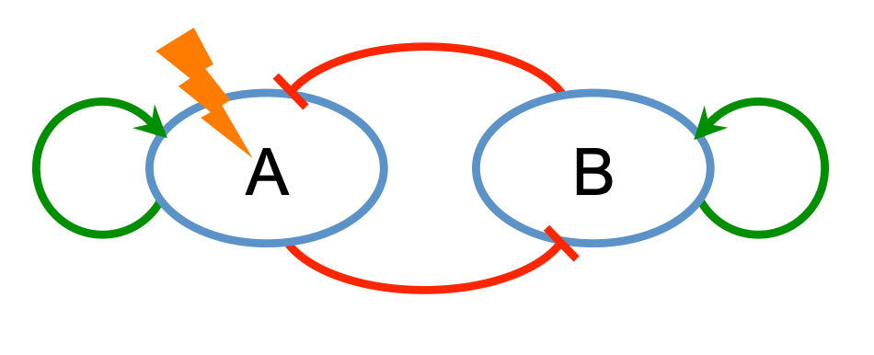
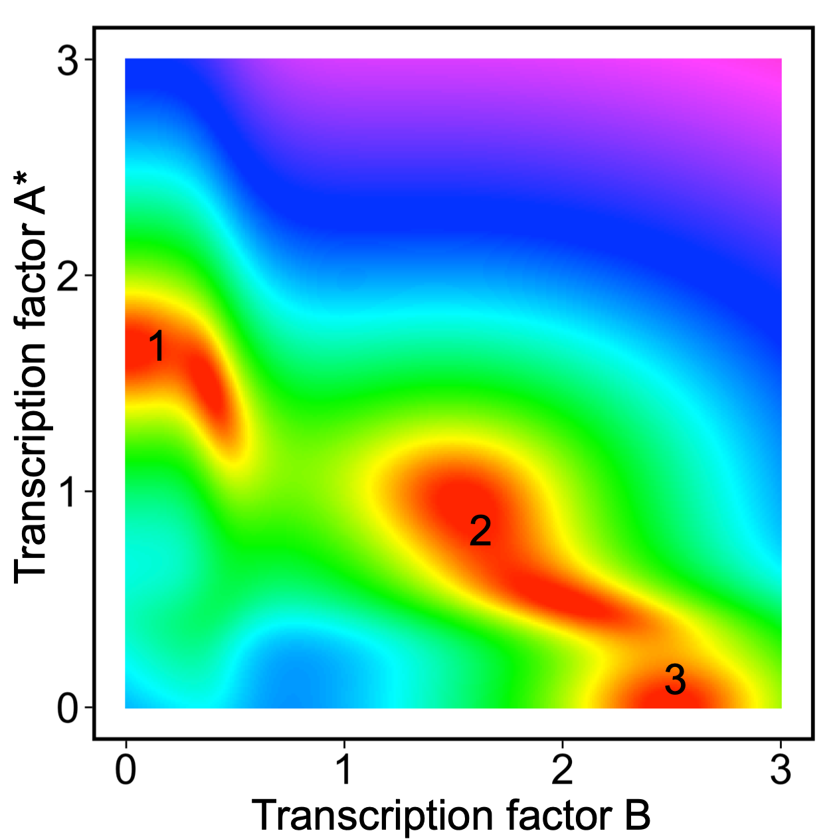
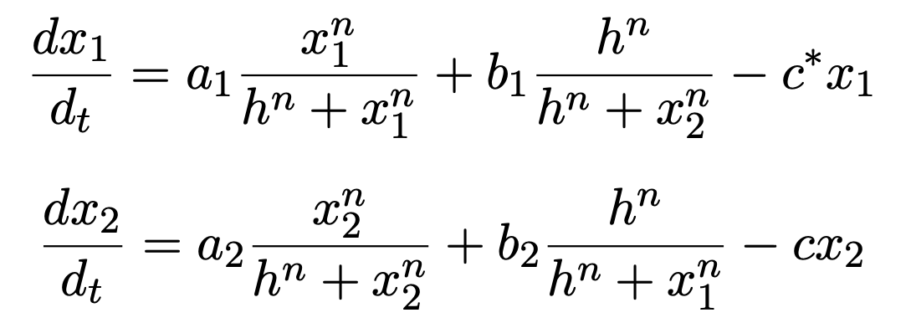
Perturbation

Slide 28
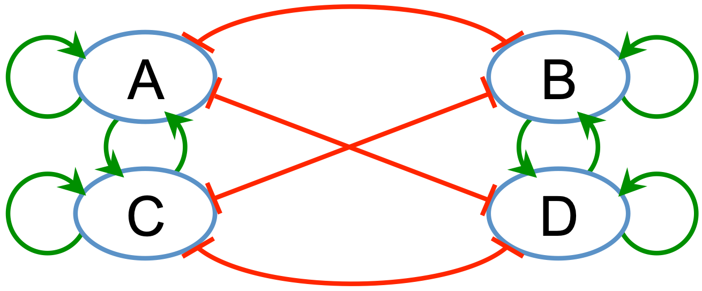
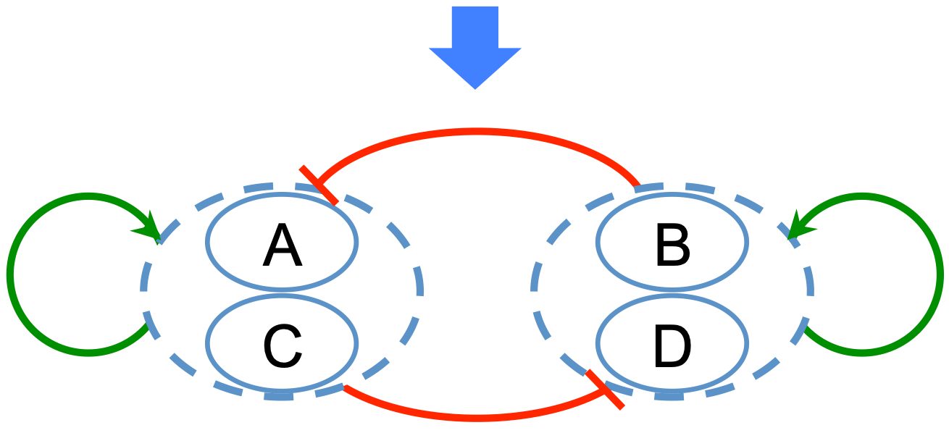
Two-Cluster Circuit

Slide 29
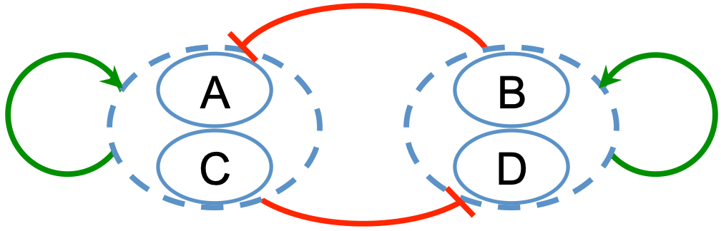
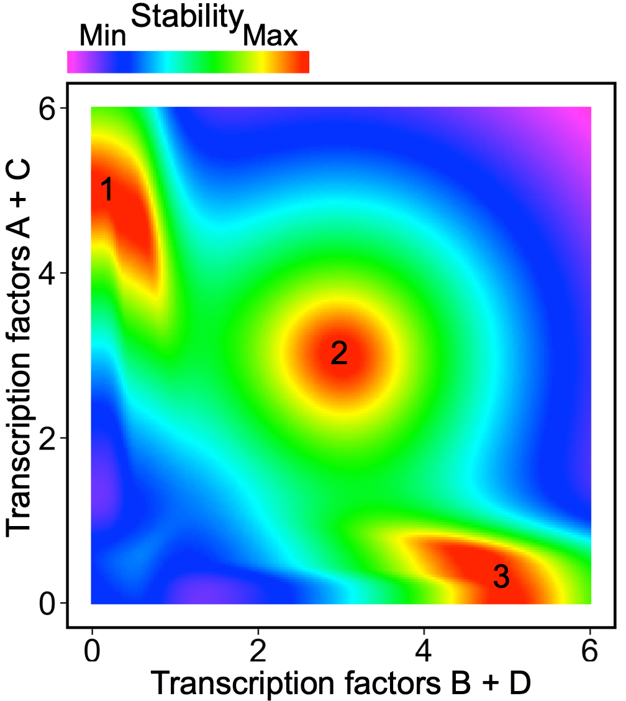
Two-Cluster Attractors

Slide 30
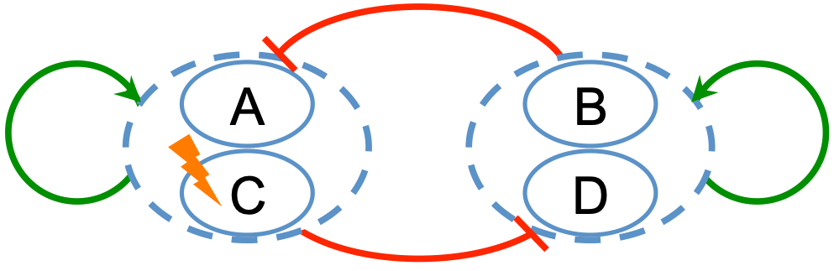
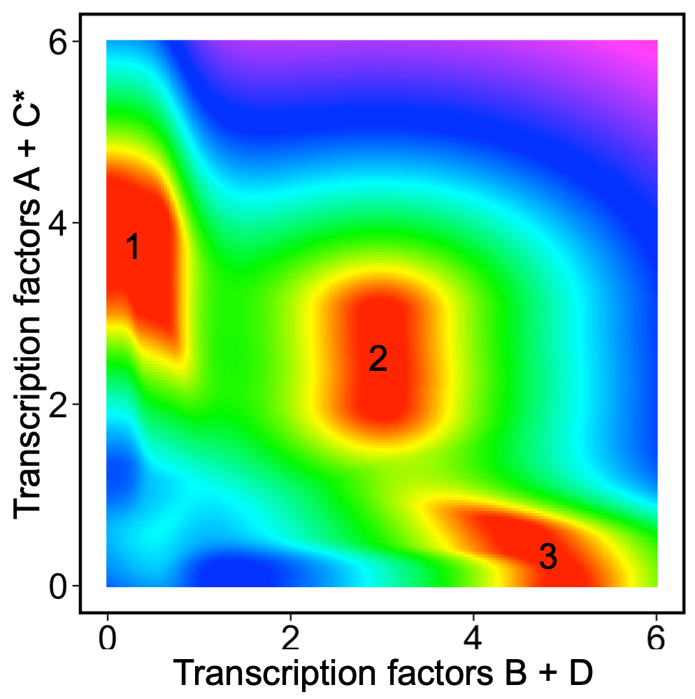
Robustness Comparison

Slide 31
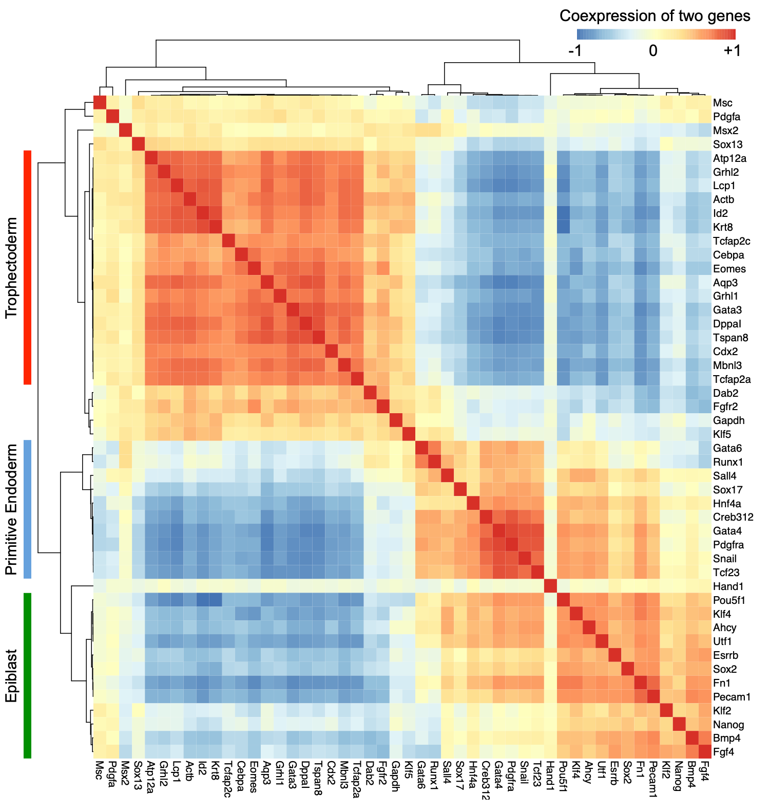
Clusters

Slide 32
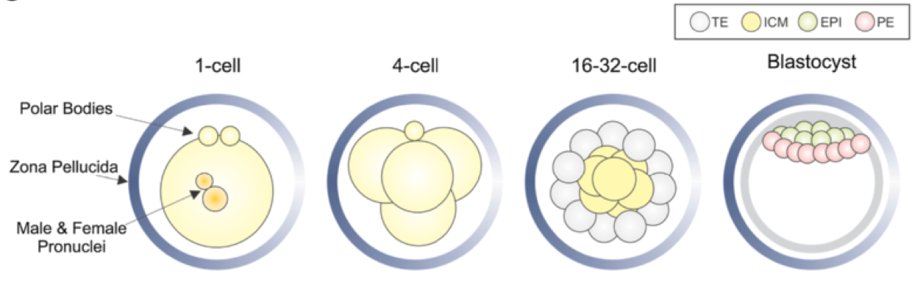
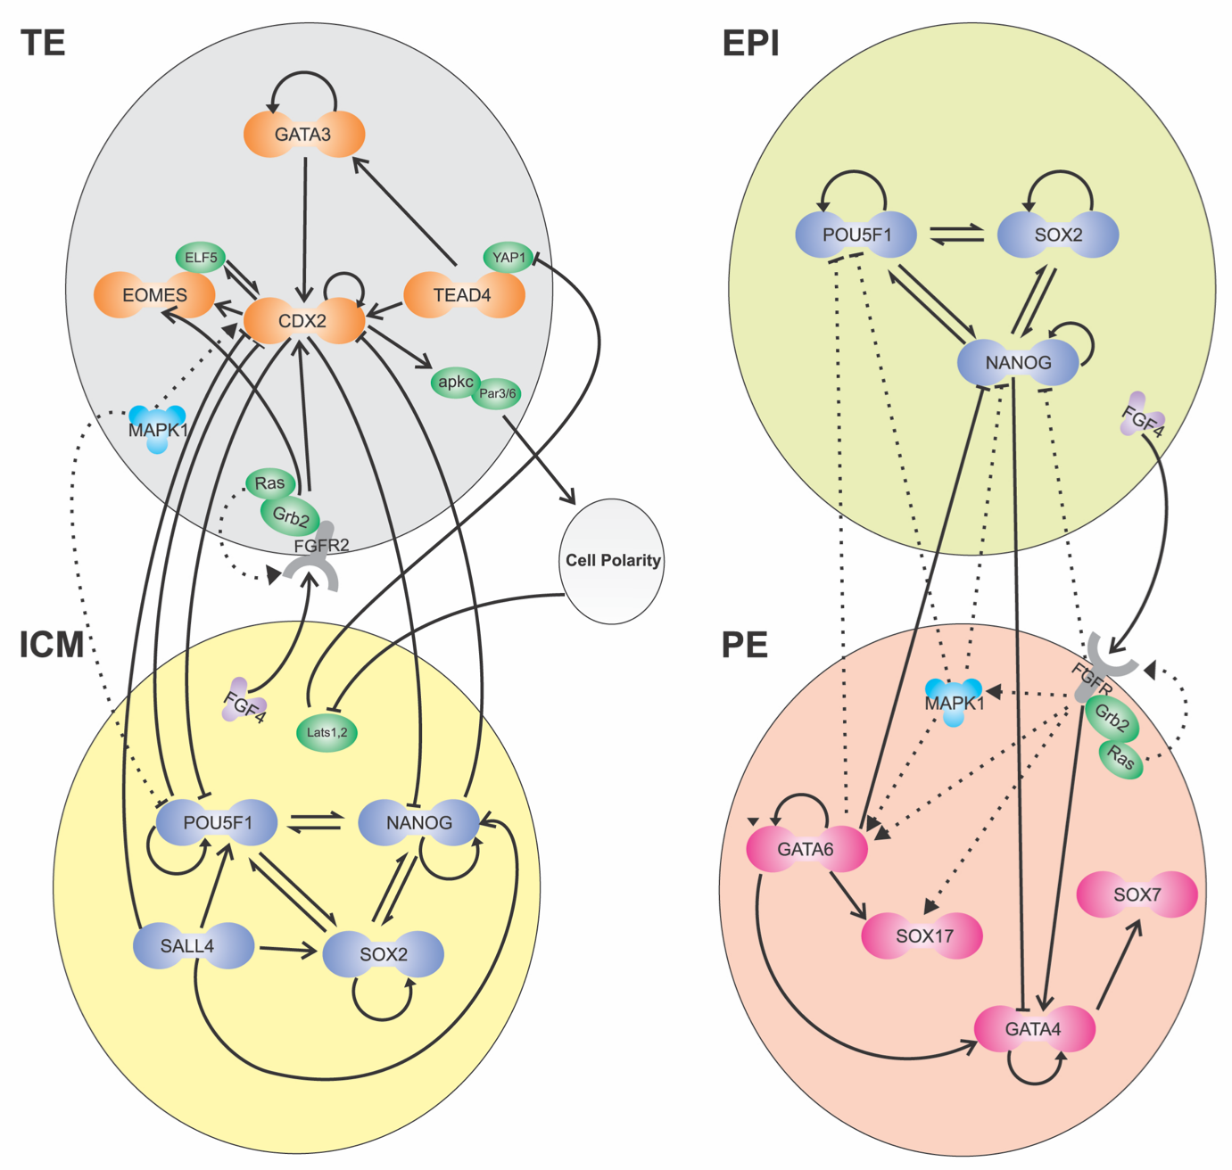
Clusters

Slide 33
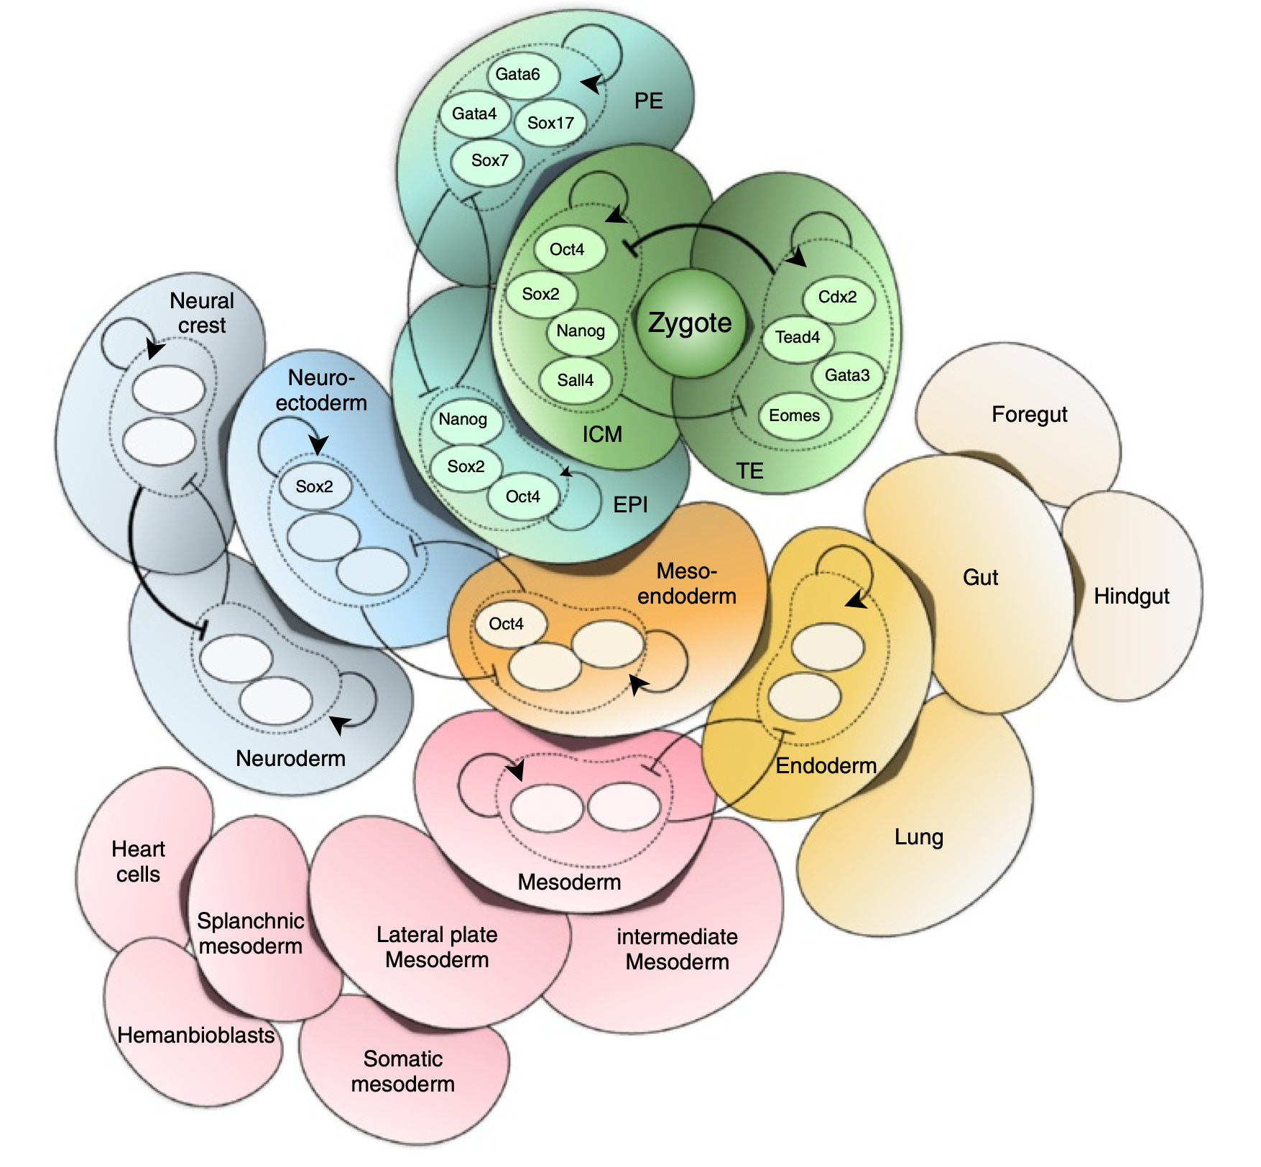
Two-Cluster Model

Slide 34


Slide 35
